Slide 1



Vendor and supplier risks

Slide 2



Problems
Outsource of activities
Responsibility for their vendors, suppliers
Manage suppliers
Entrust customer data

Slide 3

80% spending - business units align to suppliers
Wide - survey is a good way to get started

Slide 4








Comprehensive catalog of 3rd-party risks
Breakpoints
Basis of
scorecards
Audit
routines
Monitoring
activities

Slide 5

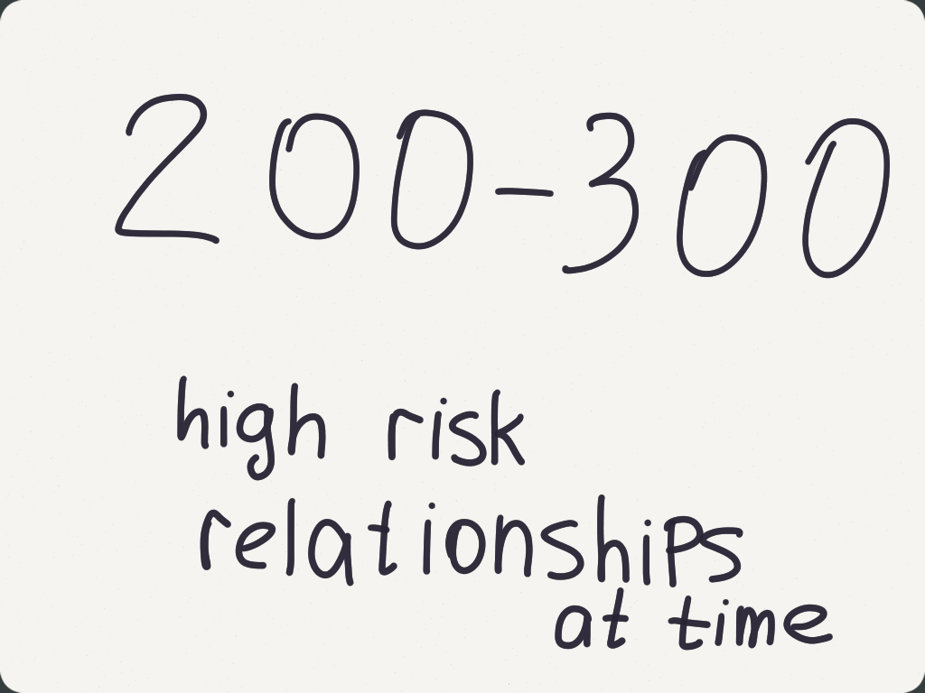


Risk-based segmentation
DETERMINE
How to utilize
resource strategically

Slide 6

Rules-based due-diligence test
Operational
IT-security risks
Strategic and
reputation risks
High-level
All
due-
diligence
Low-level

